Slide 1

HTML5 Party 1
Fundamentals
Week 1 – Full-Stack DPP Course

Slide 2
Welcome
Manuel Cubuca
Technical Trainer
Email: manuelc@justit.co.uk

Slide 3
Part 1 Outline
HTML5 Overview
The CASE STUDY
Site Map, Wireframes and Style Tile
Open an Hosting Account with one.com
Create a FREE GitHub Account
Semantic Markup and Progressive Enhancement
HTML5 Strategy
Build Website Skeleton (hands-on practice)

Slide 4
Part 1 Learning Objectives
Learners would have a good understanding of:
What is HTML5
HTML5 new features and semantic elements
What are site maps, wireframes and style tile
Create webpage structure from scratch
Deploy HTML5 semantic tags
HTML5 attributes and their use
How to build the skeleton of a website

Slide 5



The Web Development Trifecta
HTML5 – structures and describes Web page content
CSS3 – provides the formatting and "look" of a Web page
JavaScript – adds interactive, dynamic capabilities to Web pages

Slide 6
What is HTML5?
Is a collection of standards including CSS3 and JavaScript are part of the new definition:
HTML5 is the newest version of HTML and replaces HTML4
Eliminates the need and use of plugins such as flash and Silverlight
HTML5 is cross platform application
Visit the W3C website for:
HTML5 History

Slide 7
HTML5 New Features
New elements and attributes
Support for CSS3
New form controls
Video and audio integration
Graphics using Canvas
SVG
Drag and drop
Web storage
Geolocation

Slide 8
HTML5 New Semantic Elements (block elements)
Section
Nav
Header
Article
Footer
Aside
Figure
Figcaption
Address
Video and Audio
Canvas
Summary and Details
w3schools HTML tags
Periodic HTML table

Slide 9
HTML5 New Semantic Elements (inline elements)
Mark
Meter
Progress
Output
Time
w3schools HTML tags
Periodic HTML table

Slide 10
Resources
Pluralsight video tutorials (HTML5 tutorials)
HTML & CSS (book)
VLE
W3Schools
Stack Overflow

Slide 11
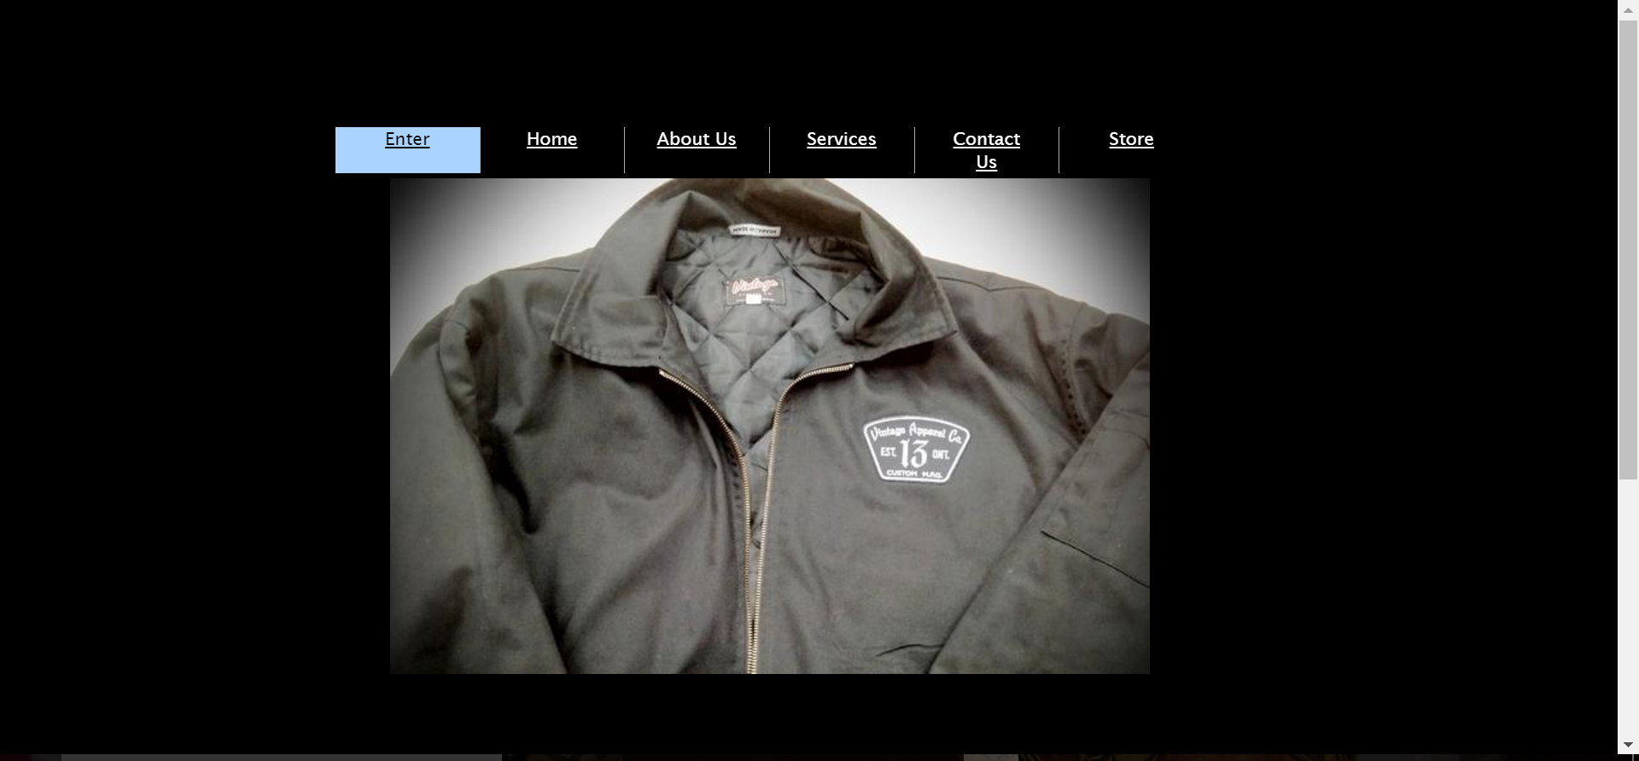
What we are updating
The Vintage Apparel Company:

Slide 12
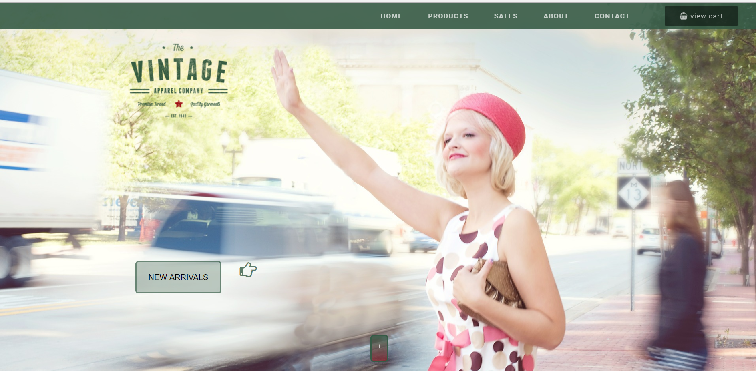
Hand coding from scratch
Modern, user friendly, interactive and responsive:

Slide 13
Website Site Map (single page)
Home Section or Landing Page
Products Section
Sales Section
About Section
Contact Section

Slide 14
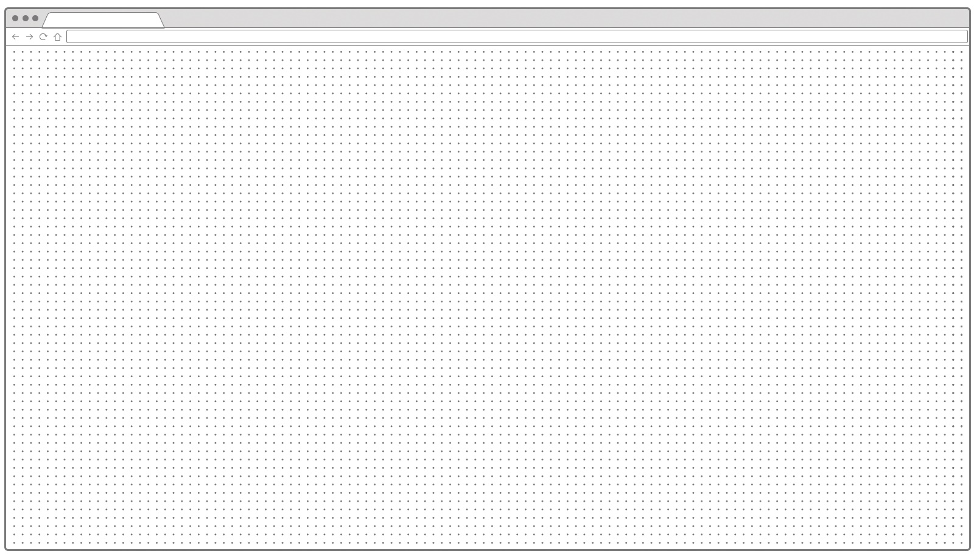
Website Wireframes
Company logo
Full screen background image
Hero section image
Action Button

Slide 15
Website Wireframes
Company Logo
Company Logo
Full screen background image
Hero section image
Full screen background image
Hero section image
Action Button
Action Button

Slide 16




Website Style Tile
Featured Products
All the best and unique vintage collection at exclusive PRICES!

Slide 17
The Case Study

Slide 18
Download Files
Login into your VLE, look for HTML5 and CSS3 folder. Inside the folder click on HTML5 Part 1.
or
Access my GitHub account and download the
HTML5 Part1 folder.
https://github.com/biatoSalo

Slide 19
Hosting account and GitHub
Open a hosting account with one.com and also buy a domain name. Once that is done, we will create a FREE account with GitHub.
ONE.COM
GitHub
Pluralsight GitHub Tutorial

Slide 20
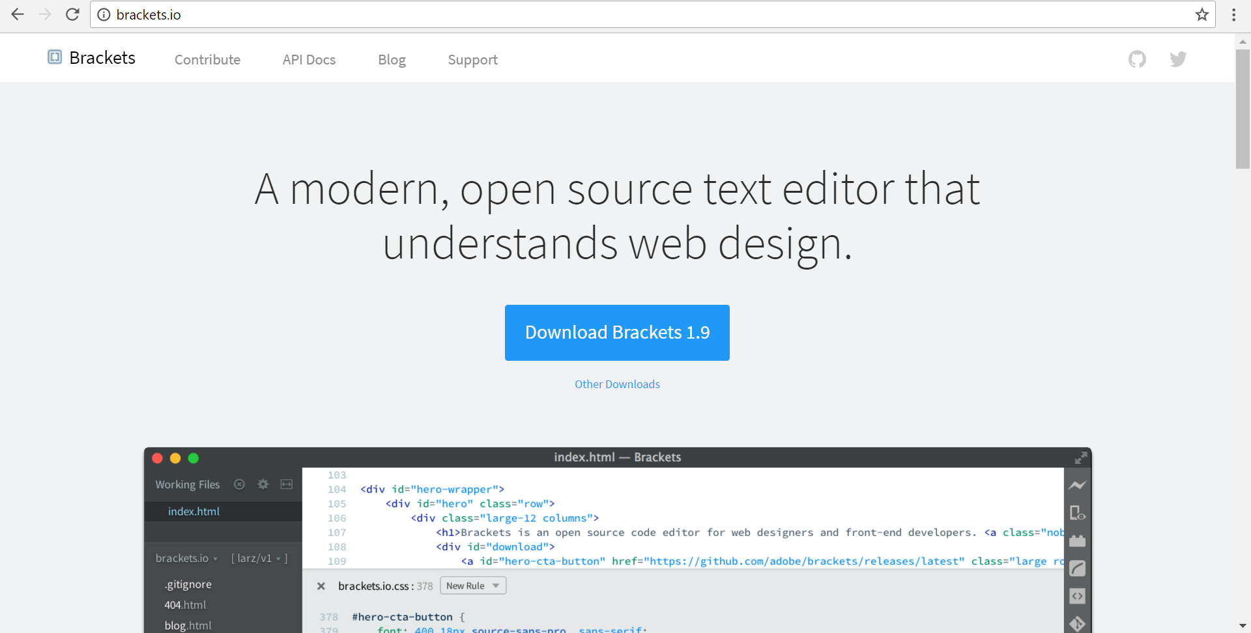
Text Editor

Slide 21
Semantic Markup and Progressive Enhancement
Semantic HTML is the use of HTML markup to reinforce the semantics, or meaning, of the information in web pages and web applications rather than merely to define its presentation or look.
The practice of adding technology in layers to a website to ensure that if all fails, content can still be accessed.
Separation of concerns
HTML
CSS
JAVASCRIPT
CONTENT
PRESENTATION
BEHAVIOUR

Slide 22

HTML Strategy
<section>
<header>
<div>
<nav>
<ul>
<li>
<a>
<div>
<div>
<div>
<div>
<a>
<i>
<img>
<a>
<span>

Slide 23
Any Questions?
Let’s code

